Slide 1
Dynamic Traffic Signal Management using IOT
- Data Diggers

Slide 2
Present Traffic Signal control system
They are a time-based systems
Traffic Congestion
Accidents
Waste of time, Property damage, environmental pollution
Ultimately and slowly leads to huge financial losses

Slide 3
What are we doing?
Managing the Traffic based on the density of the car present on each lane using IoT.
Providing a mechanism for the occurrence of the emergency vehicle
Providing Real Time Traffic information to the Users.

Slide 4
What are we doing?
Less Congestion
Improved Fuel Consumption
Vehicle Emissions Reduced
Improved Air Quality

Slide 5
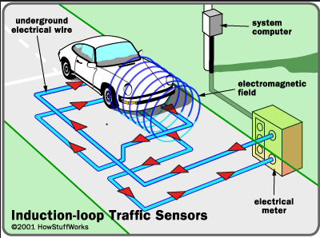
Why existing technology fails?
Induction Loops – Expensive to implement

Slide 6

Why existing technology fails?
Induction Loops – Expensive to implement

Slide 7
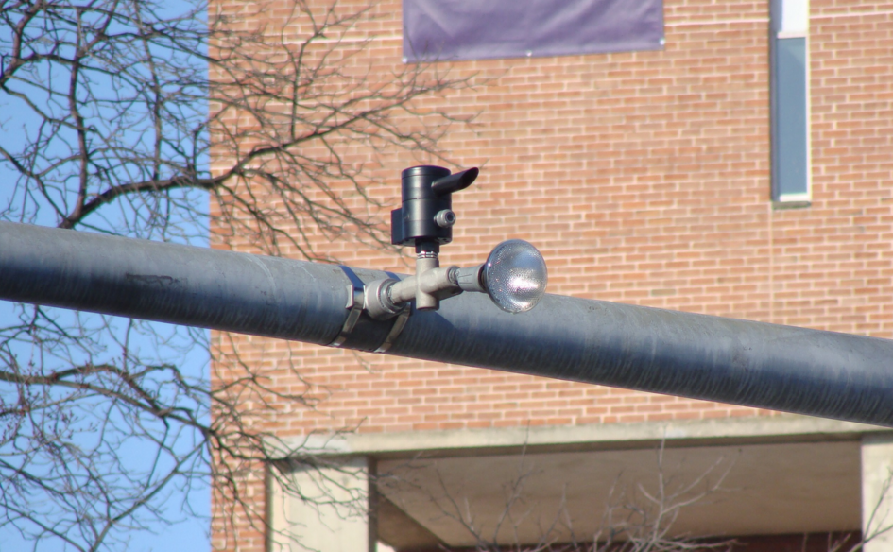
Why existing technology fails?
Induction Loops – Expensive to implement
Infrared Sensors – Poor efficiency

Slide 8
Why existing technology fails?
Induction Loops – Expensive to implement
Infrared Sensors – Poor efficiency

Slide 9
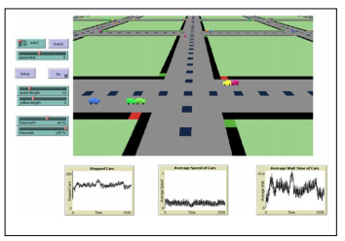
Why existing technology fails?
Induction Loops – Expensive to implement
Infrared Sensors – Poor efficiency
Image processing Technology – Dependent on weather condition

Slide 10
Why existing technology fails?
Induction Loops – Expensive to implement
Infrared Sensors – Poor efficiency
Image processing Technology – Dependent on weather condition

Slide 12
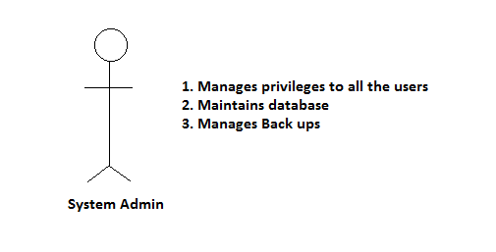
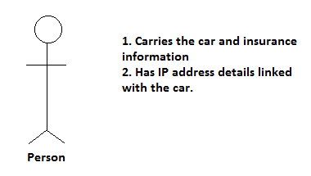
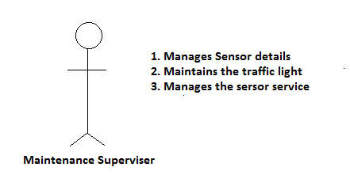
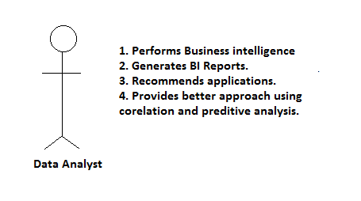
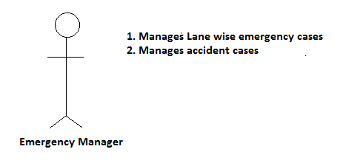

Slide 13
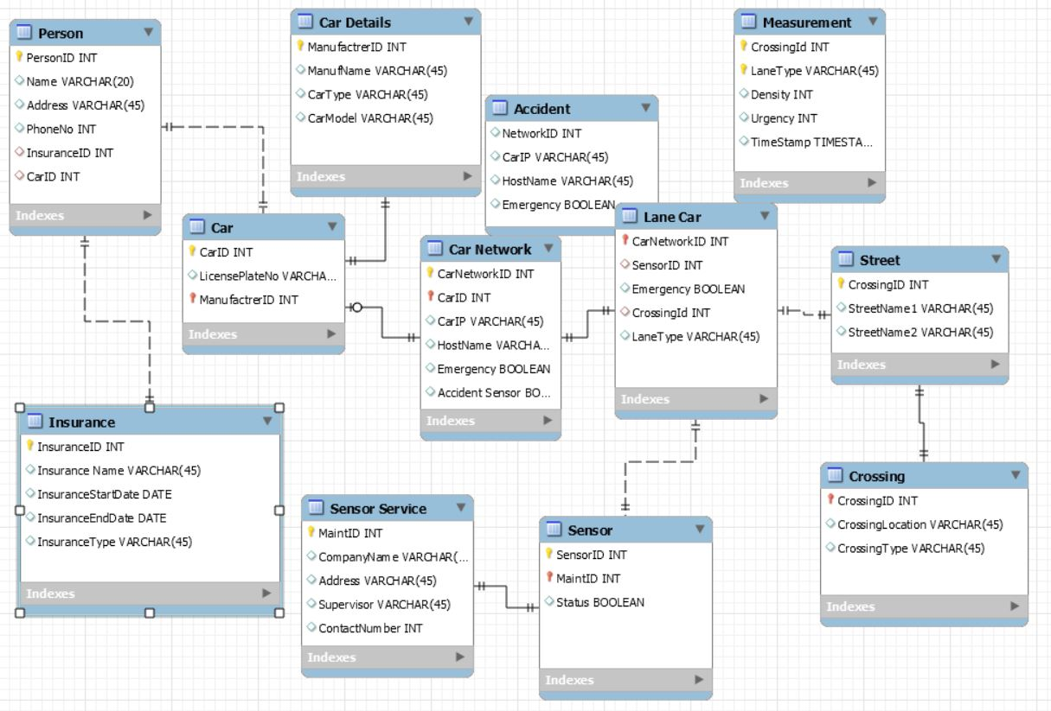

Slide 14
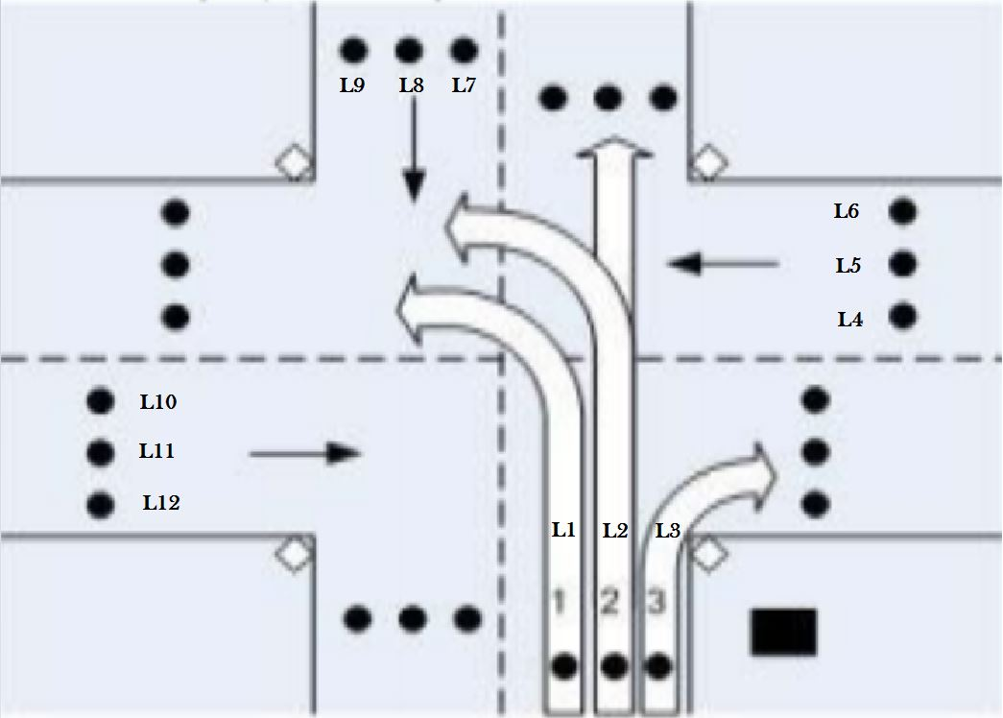

Slide 15
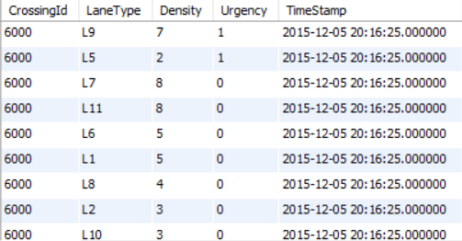

Slide 16
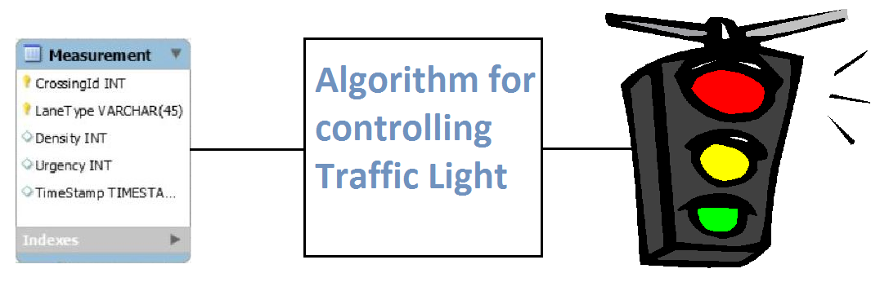

Slide 17
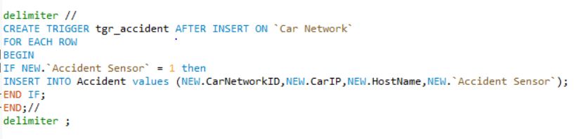
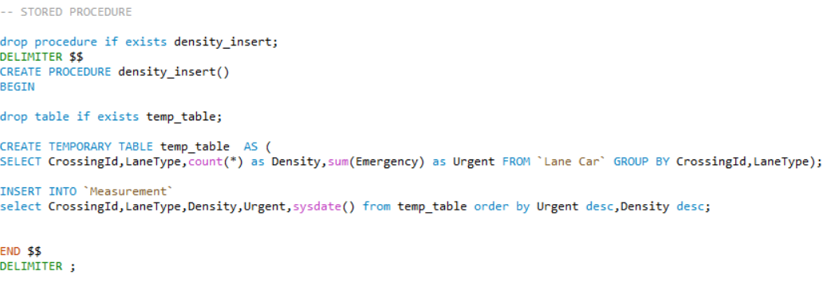

Slide 18
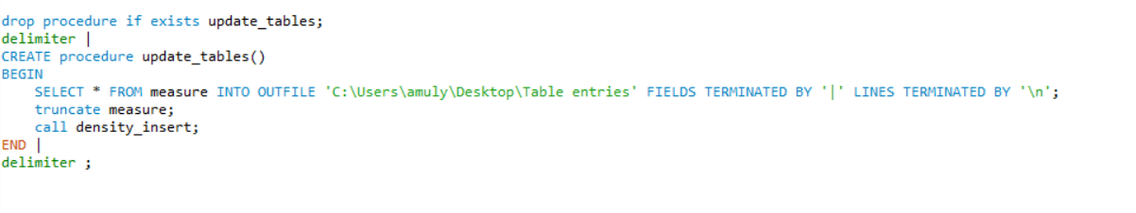
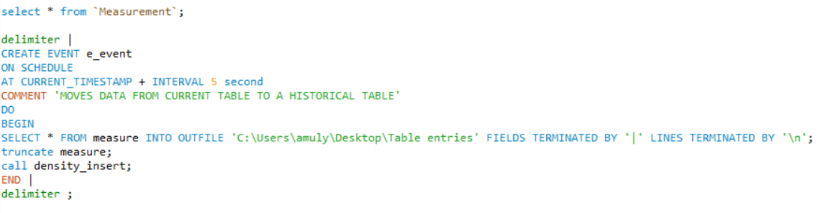

Slide 19
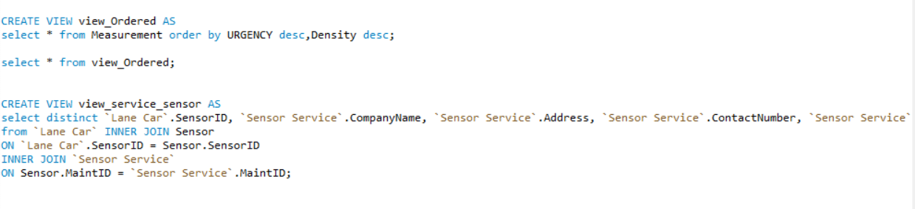

Slide 20
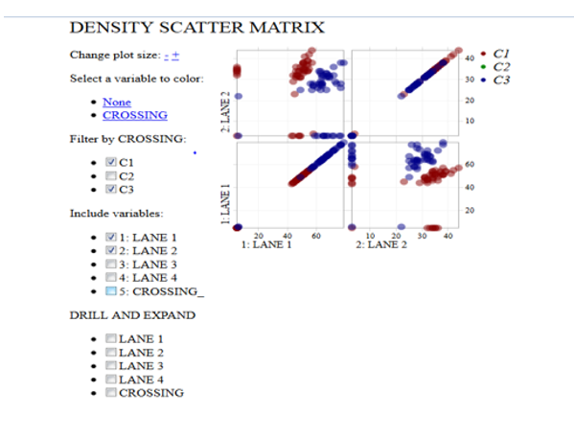

Slide 21
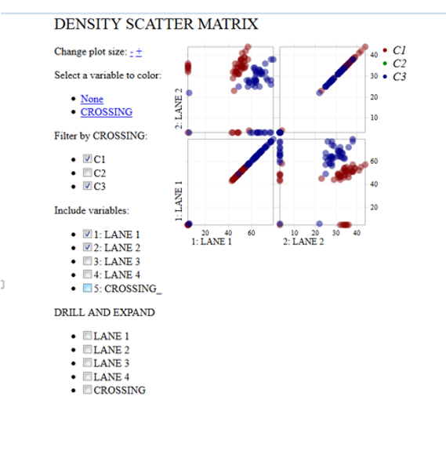

Slide 22
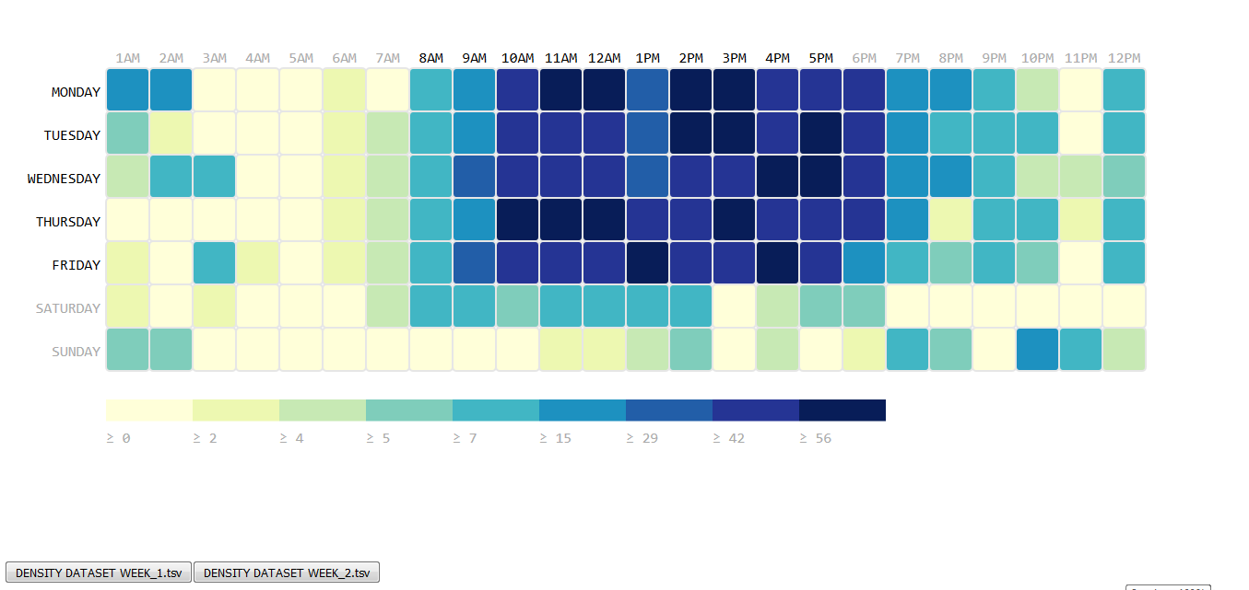

Slide 24
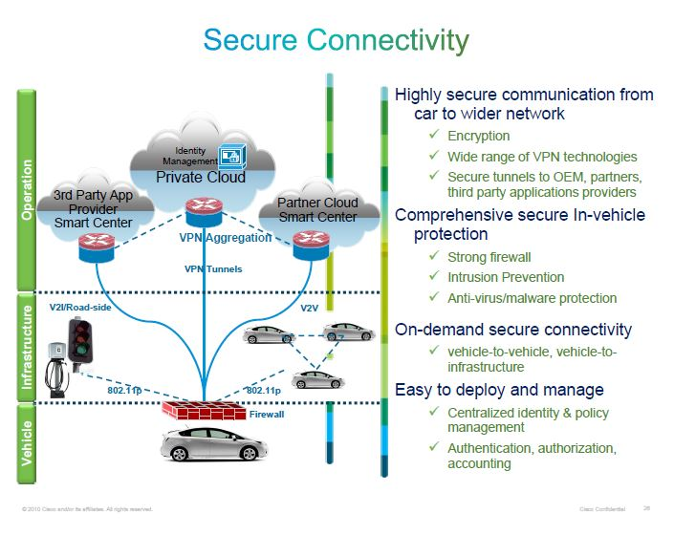

Slide 25
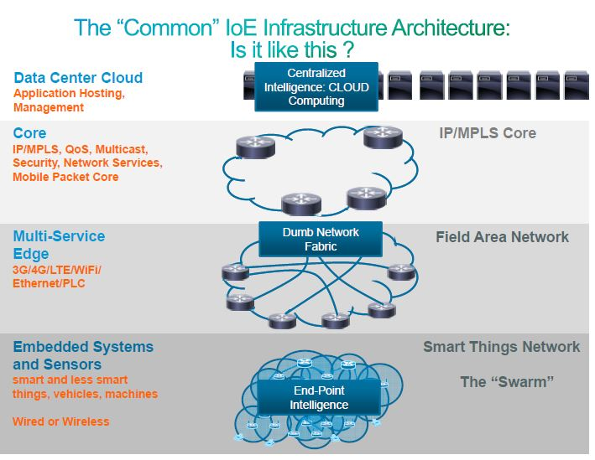

Slide 26
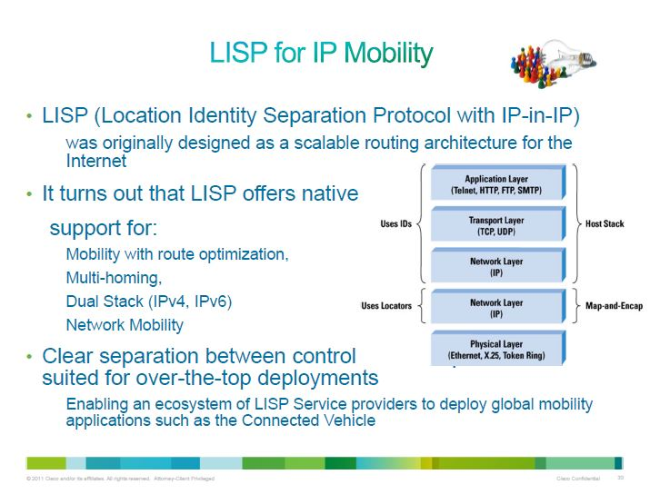

Slide 27
Assumptions
1) Every car has an IP Address and has internet connection
2) Sensors that calculate the number of cars in a particular lane in a street using the IP address.
3) Sensors that can detect car IP addresses up to 100 meter.
4) Each road in an intersection has six lanes (three lanes for each direction).
5) Every crossing is a 4 way.
6) The cars are on the correct lane according to the directions.

Slide 28
Future Work
1) Providing a phone interface to the user with SMS facility to those who wish to obtain the latest traffic information on congested roads.
2) Communication between the subsequent traffic lights in case the emergency vehicle is approaching.

Slide 30
THANK YOU!!!

